Slide 1
Red Bank Regional High School
Special Services Program Introduction
April 4, 2023

Slide 2
Welcome to Red Bank Regional High School
With an enrollment of approximately 1300 students, Red Bank Regional High School offers a wide array of educational opportunities for students in grades 9-12 through a comprehensive program of curricular and co-curricular studies
The transition to High School can be a daunting and nerve-wracking process! The staff of RBR is here to help and has prepared this information to provide you an introduction to the special education programming available at RBRHS.
This presentation is not exhaustive, so please reach out to a case manager with any specific questions you may have!
Articulation is held each year with sending districts prior to scheduling to provide RBR case managers information on incoming students.

Slide 3
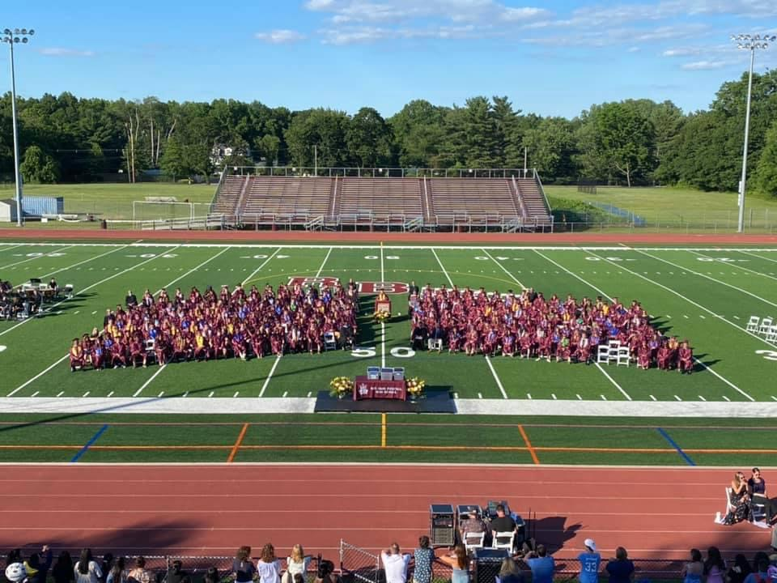
Mission Statement
To ensure the academic success and personal growth of all students while developing a passion for lifelong learning.

Slide 4
Freshman Academy
Incoming Freshman are assigned to one of three houses: Maroon, Gray, or White
Each house consists of cross curricular teams of English, math, science and social studies teachers
Common planning time is provided for teams to meet
One guidance counselor is assigned to each house to streamline communication and supports

Slide 5
Supports
Child Study Team and Case Managers
School Counseling Department
The SOURCE
Academic Mentoring
Community tutoring
Lunchtime tutoring
Homework help
Peer tutoring
Summer Slam Program for incoming freshmen

Slide 6
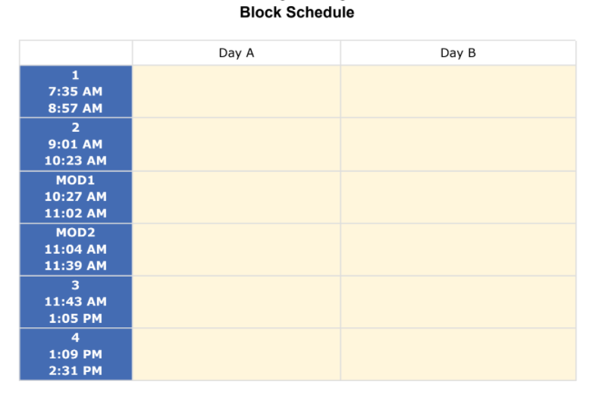
Our School Day
RBR utilizes an alternating A/B day schedule with 82 minute blocks
Lunch
Lunch
Study Hall
Study Hall

Slide 7
Academic Progression
9
10
11
12
English
Algebra I
Biology
Global Studies
PE/Health
World Language
Elective
Elective
English
Geometry
Chemistry
US History I
PE/Health
World Language
Elective
Elective
English
Algebra II
Science
US History II
PE/Health
World Language
Elective
Elective
English
Math
PE/Health
Elective
Elective
Elective
Based upon student need, additional programming through the 21st year may be available
Core course are available at the Resource, ICS and General level
Consult the Course of Study Guide for AP, IB and DE options

Slide 8
Programming at RBR
General Education (taught by general ed teacher)
In-class Resource (co-taught by general and special education teacher)
Pull-out Replacement Resource (taught by special education teacher)
Self-Contained (taught by special education teachers)
Related Services
Instructional Aides
Notes:
Additional: Speech, counseling, OT, PT, transportation, Career Center

Slide 9
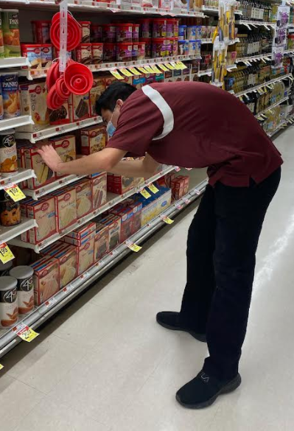
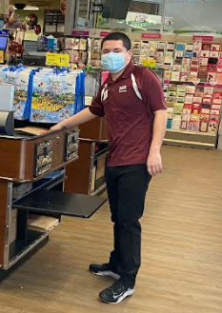
Work Experience and Vocational Opportunities
Monmouth County Vocational School District
The Career Center
Work-Based Learning (WBL)
Auto Services, Baking, Building Services, Building Trades, Food Service, Horticulture Floral, Horticulture Landscaping, Marketing Education, Materials Handling, Computer & Business Applications, Supermarket Careers
The mission of the Work Based Learning Program is to combine learning with hands-on work experience. As an intern, students learn job skills on-site with a trained job coach. Our current locations include: Marriott, Acme, Lunch Break, Marshalls, and Monmouth County Library. Sites are added and modified based on student interest and independence.

Slide 10
Summer Programming
Summer Slam
  4 week transition program for incoming freshman 7/10-8/3
  Challenging curriculum includes Language Arts, Math, Science, History and Social Emotional Learning (SEL) skills
An Extended School Year program (ESY) is provided to eligible students to prevent regression and includes:
  Academics, Life skills, Social skills, Related services
  ESY 2023 will run 7/10-8/10 Monday through Thursday from 8 - 1 pm (lunch and transportation provided)
  Lunch and Transportation is available

Slide 11
Freshman Orientation
All incoming freshman are invited to participate in Freshman Orientation
Students will have the opportunity to meet their Freshman Academy teachers, meet students from other districts, tour the school, participate in ice breaker activities, and discover all the many clubs, sports and activities available at RBR
Date: Tentative August 23 from 2:30-5:30pm
Parents welcome 5:30-6:30pm
Transportation provided to the school only

Slide 12
Helpful Information
Parent Portal
Google Classroom
Communication
College Board
Attendance
Credits and Diplomas
School Calendar

Slide 13
Extracurricular Activities
Students are encouraged to try-out and join any sports or activities that they may be interested in. A modified program is offered year round for students who require support and supervision.
A full list of clubs, in school and after school programs and can be found on the website at www.rbrhs.org

Slide 14
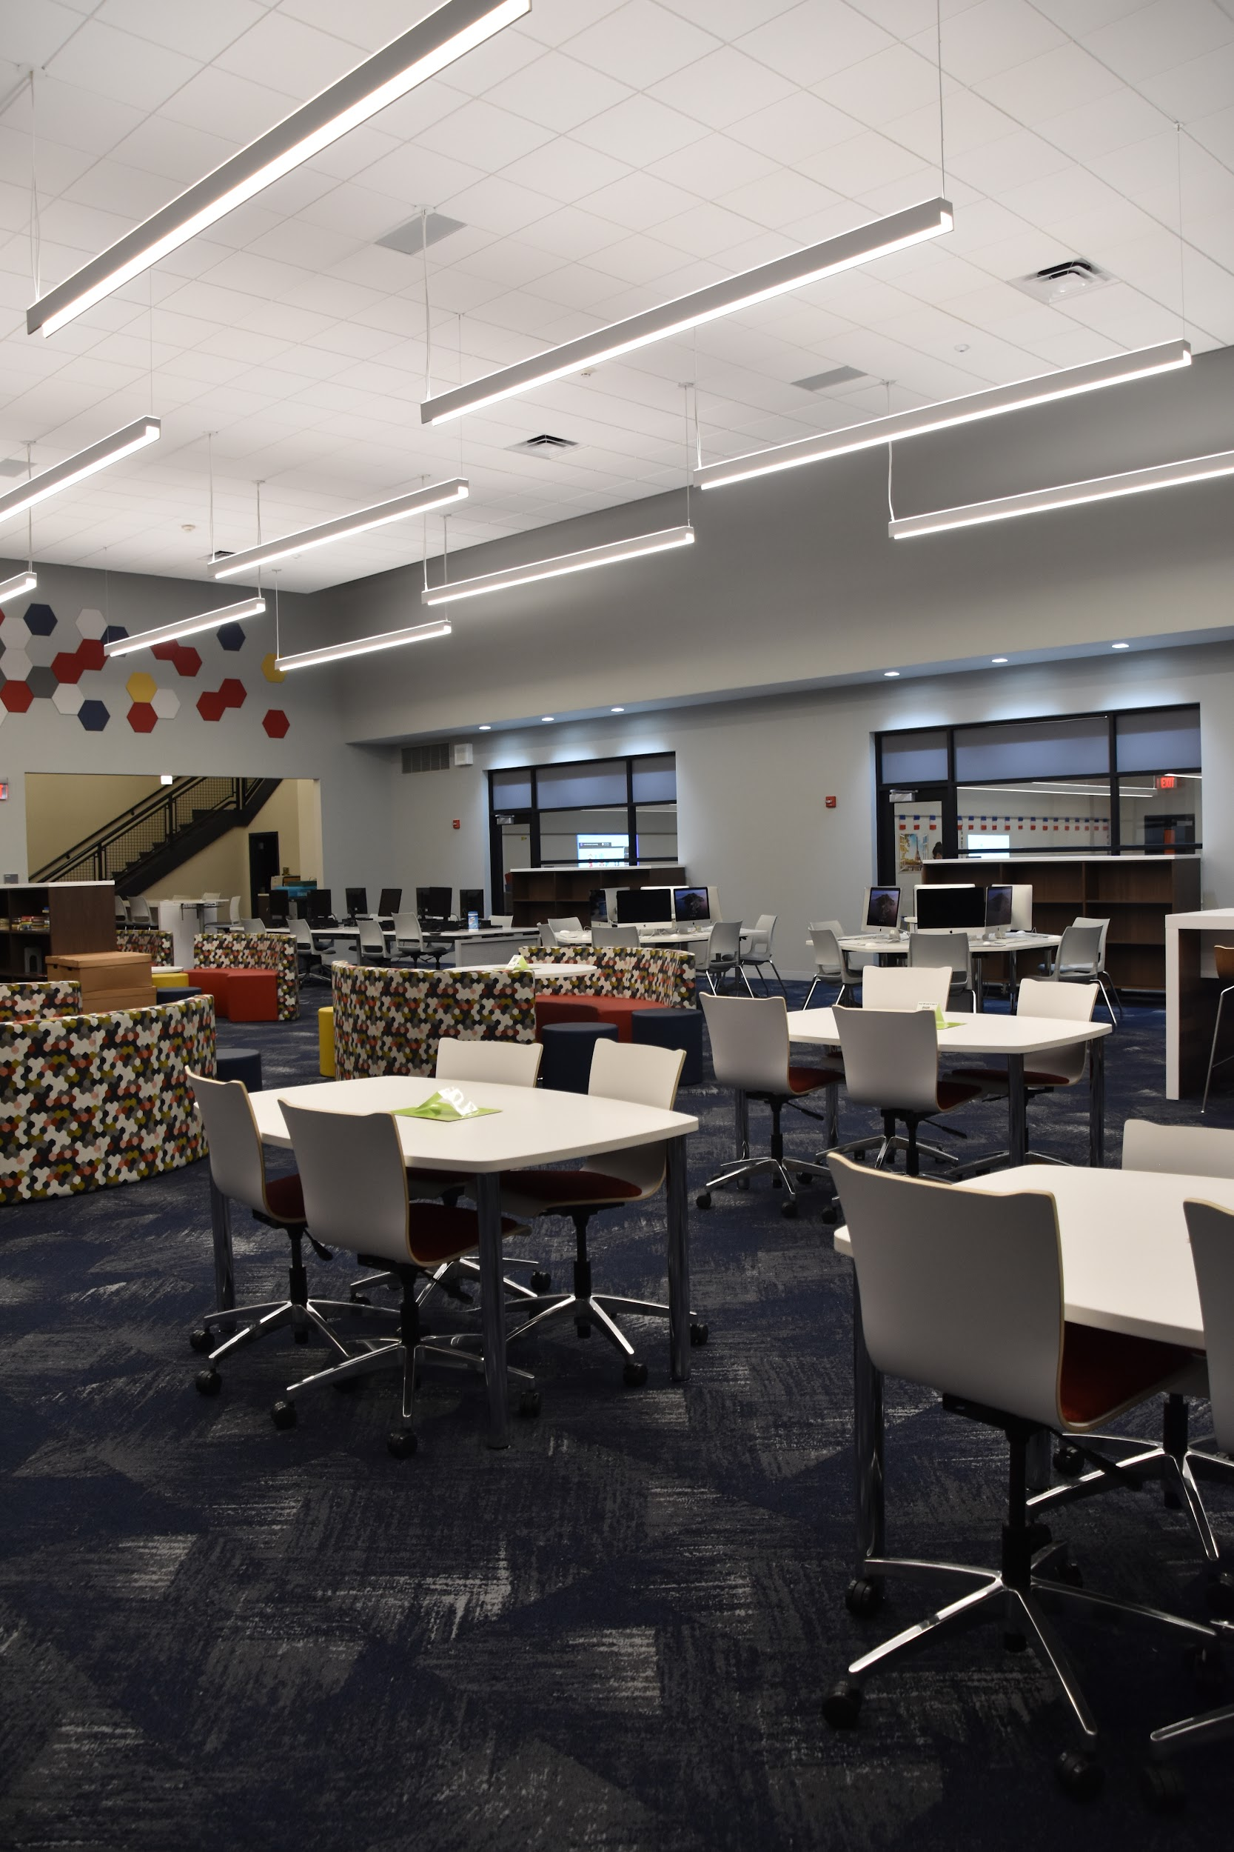
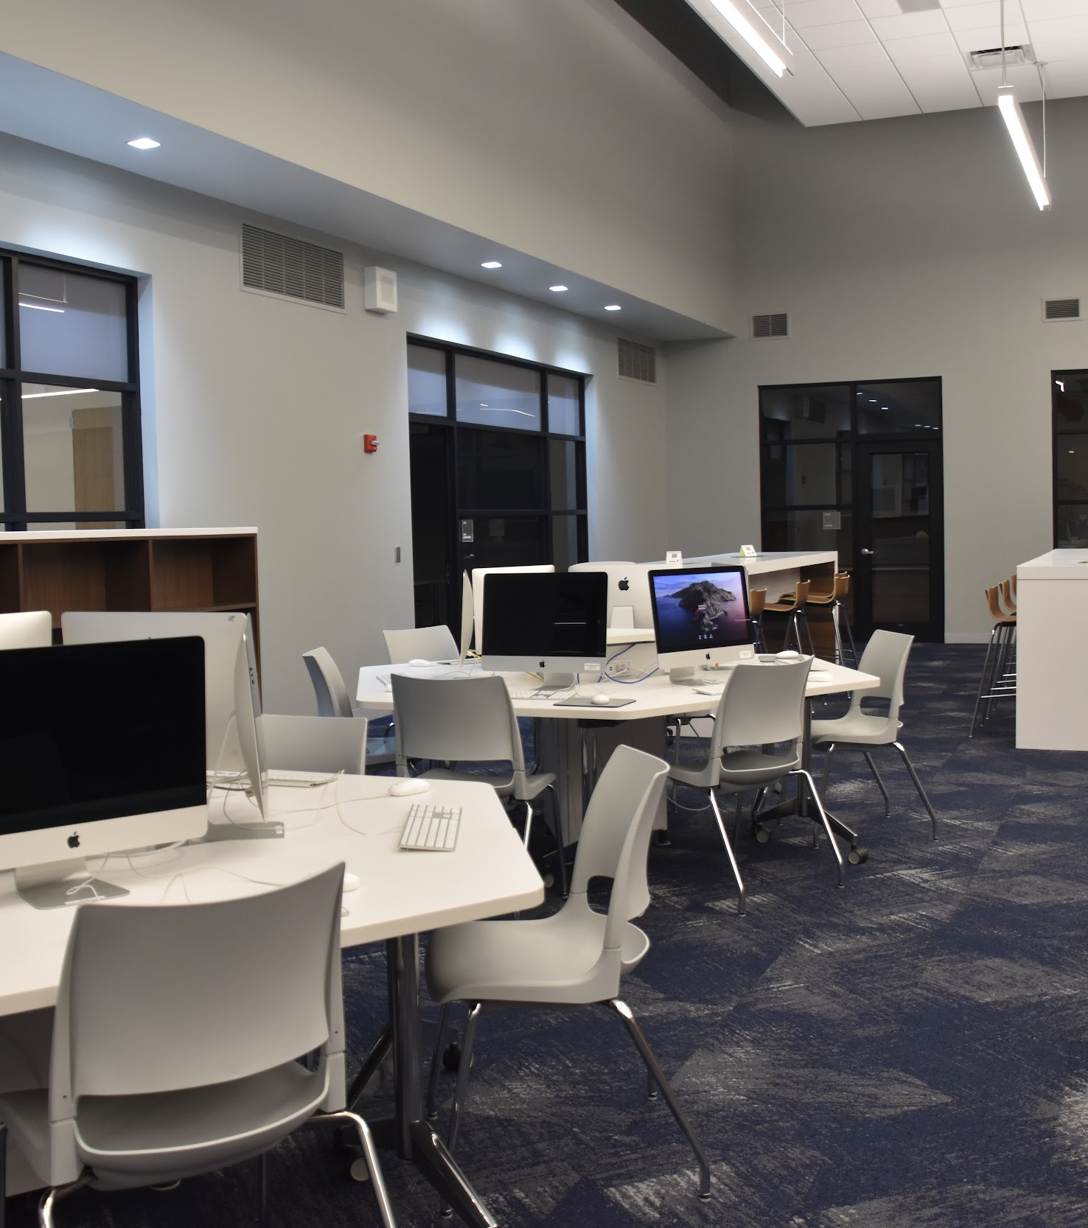
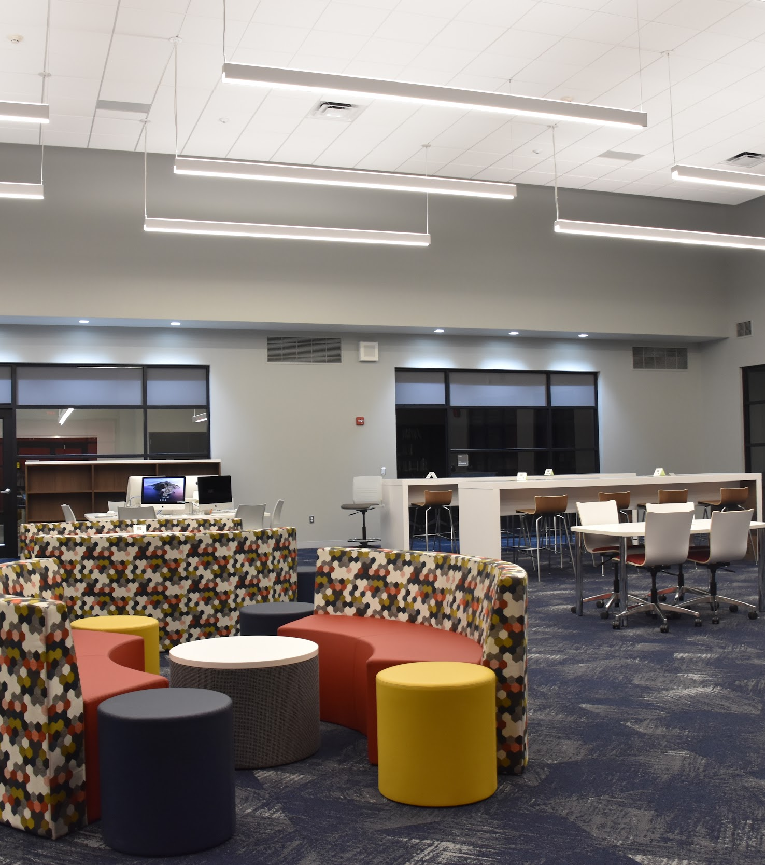
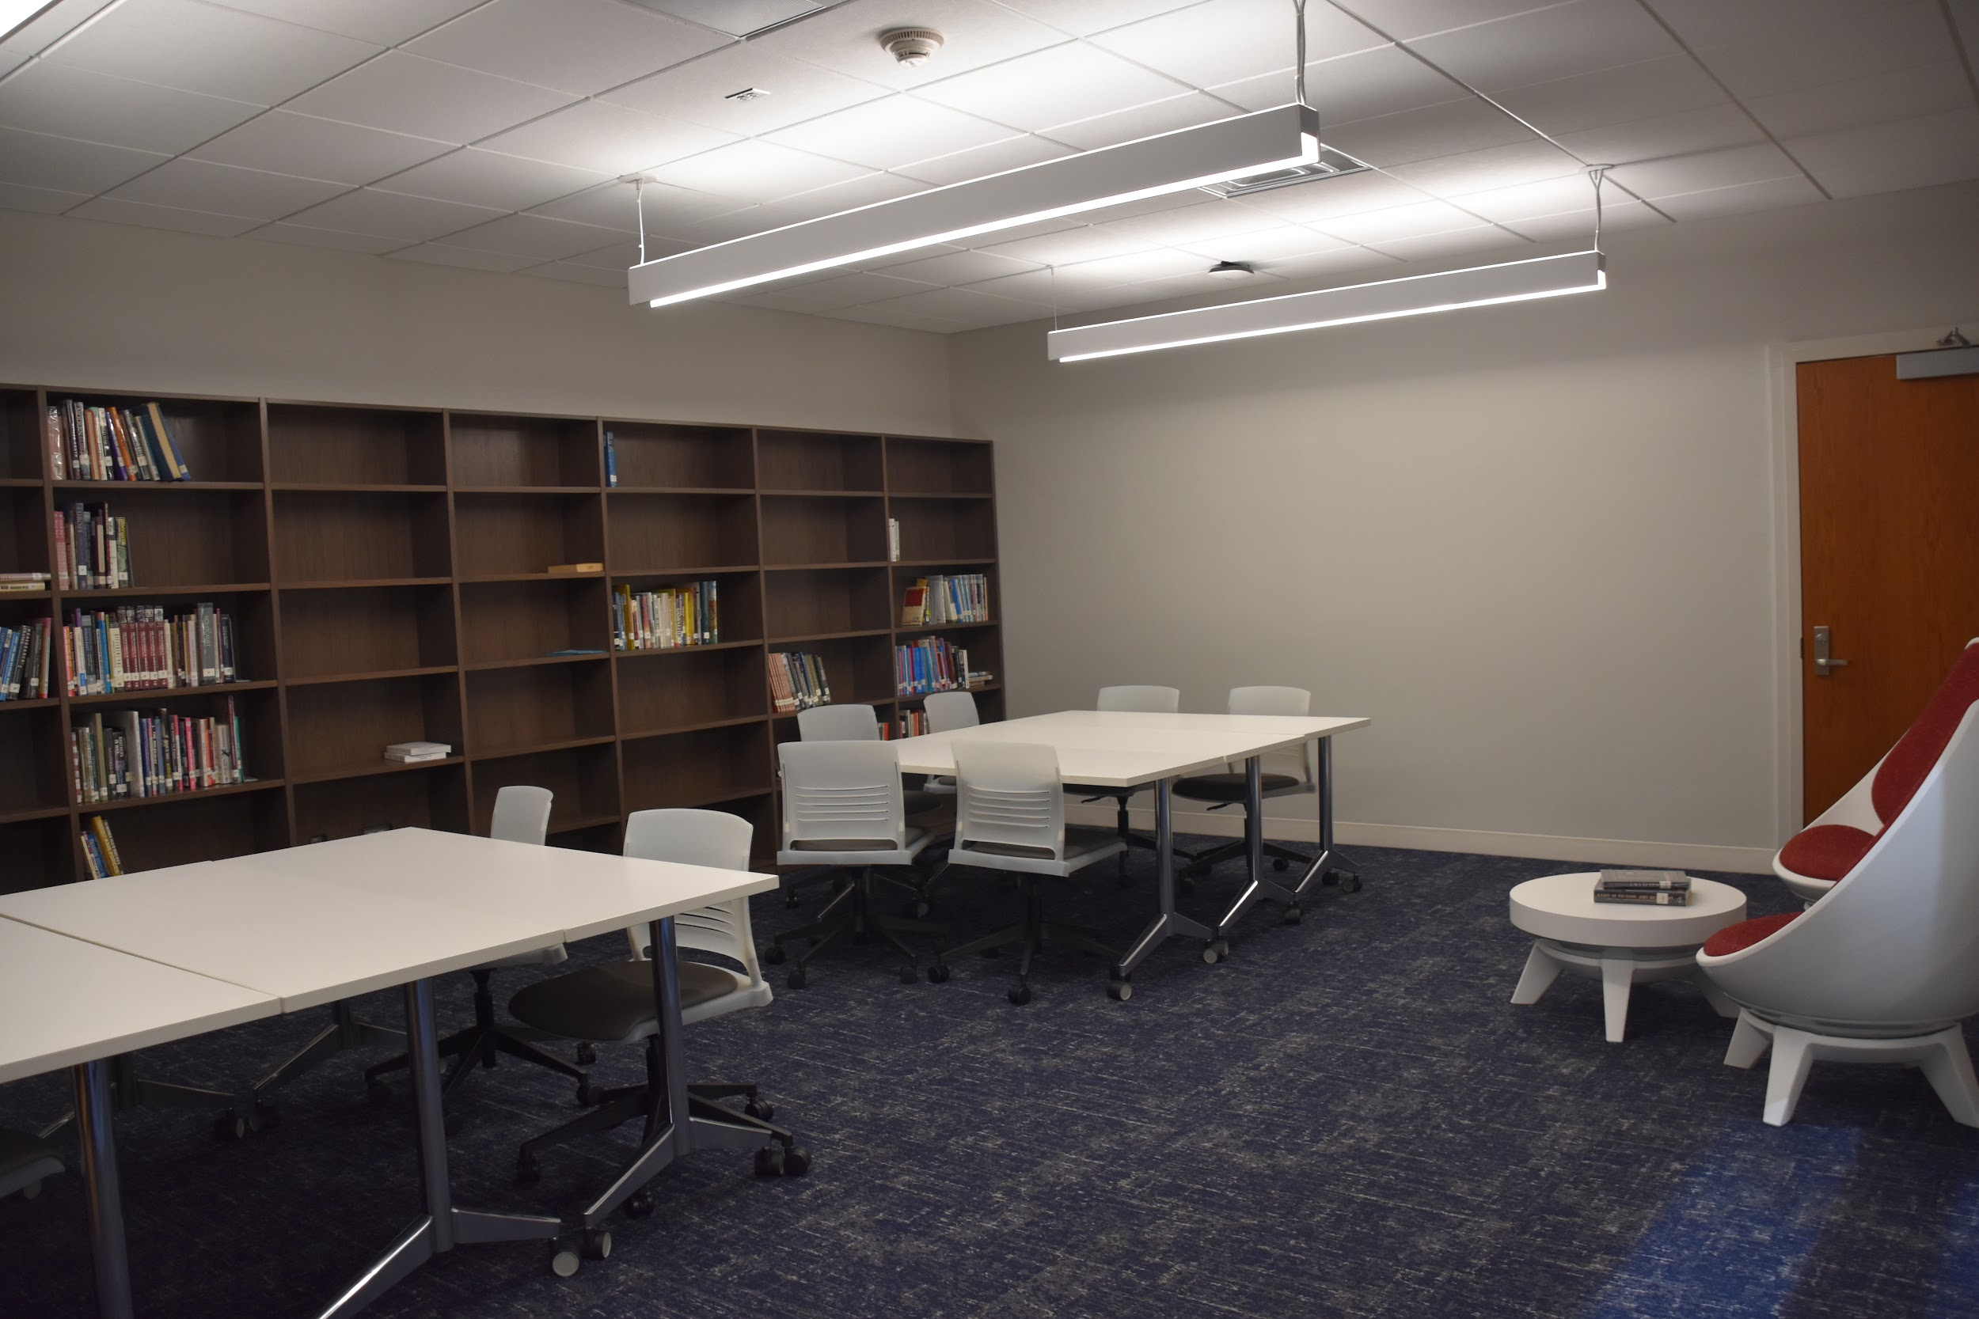
Gatherings space and work tables
The New Media Center
Computer Work Stations
Work Tables, Reading areas
& New Classrooms
Quiet Reading/Study Room
Notes:
Lou

Slide 15
What makes a successful high school student?
Self-Awareness
Stress Management
Help Seeking Behaviors
Resilience
Self-Confidence

Slide 16
Child Study Team
Teresa Shulman
LDTC
tshulman@rbrhs.org; ext. 439
Dr. Suzanne Alvarado
School Psychologist
salvarado@rbrhs.org; ext.234
Jennifer Massell
Reading Specialist
jmassell@rbrhs.org
Samantha Larsen
School Psychologist
slarsen@rbrhs.org ; ext 413
Erinmarie Ciallella
Speech Therapist
eciallella@rbrhs.org; ext.356
Brigid Laudermilch
School Social Worker
blaudermilch@rbrhs.org; ext. 442
Audrey McGarry
LDTC
amcgarry@rbrhs.org; ext. 461
Sue Alber
Administrative Assistant
salber@rbrhs.org; ext. 273

Slide 17
Thanks
Please email or call your case manager to relay any lingering questions or wonderings.
We look forward to seeing you in September!
Erin Pinto
Supervisor
epinto@rbrhs.org; ext. 231

